Slide 1
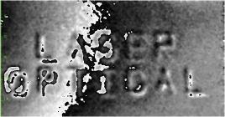
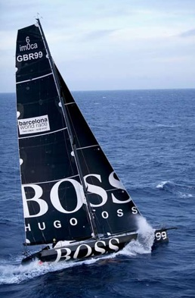
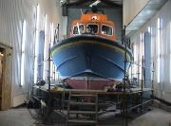
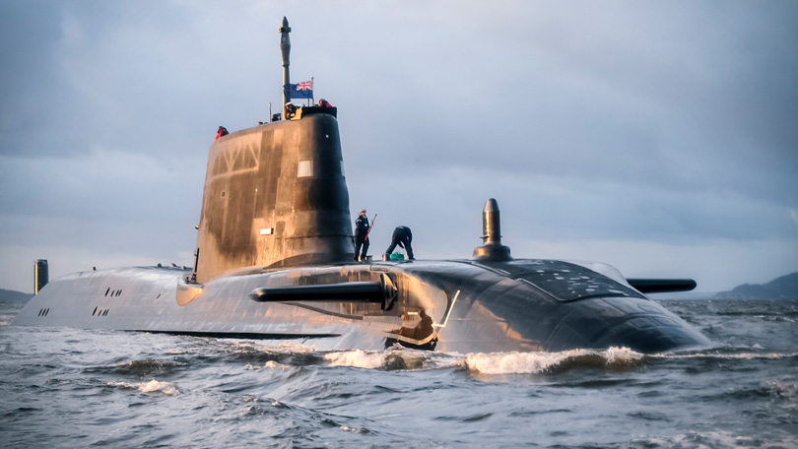
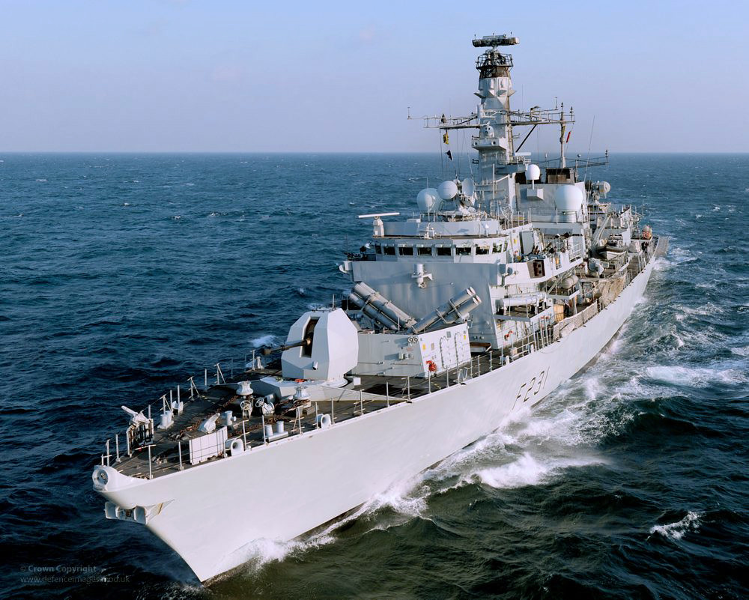
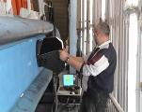
John Tyrer
Quantitative structural shearographic NDT of composite maritime structures: lessons learned from 30 years of testing maritime vessels
Shearographic image: Resin enriched detail in composite panel

Slide 2
Safety Lessons - Loss of the yacht Cheeki Rafiki and its four crew
(Paul Goslin, James Male, Steve Warren and Andrew Bridge)
MAIB - FLYER TO THE LEISURE INDUSTRY
Matrix detachment is possible in yachts where a GRP matrix and hull are bonded together. The probability of this occurring will increase with longer and harder yacht usage. There is therefore a need for regular structural inspection by a nominated competent person as part of a formal verifiable procedure, as well as before embarking on an ocean passage.
Owing to the continuous nature of a matrix where solid floors are in place, particularly where the keel is attached to the hull, it may be difficult to readily identify areas where a detachment has occurred. There are differing opinions among surveyors and GRP repairers with regard to what are appropriate methods of inspection and repair, including the circumstances in which the keel should be removed. There is therefore a desire for best practice industry-wide guidance to be developed.
Any grounding has the potential to cause significantly more damage than may be subjectively assessed or visually apparent, including matrix detachment. It is therefore important that all groundings, including those perceived to be ‘light’, result in an inspection for possible damage by a suitably competent person.

Slide 3


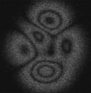
Laser Speckle Interferometry - Principles
Uses light as a ruler
Non – destructive
Non – contact
Highly sensitive
Full field measurement
Procedure:
Take reference measurement
Take measurement after loading
Subtract speckle pattern
Speckle pattern
CCD Chip
Spatially and temporally coherent illumination
Backscattered light – random phase
Optically rough surface
Notes:
I will now discuss Laser Interferometry. When spatially and temporally coherent light is incident on a surface the light scattered from the surface has a speckled appearance, this is due to the fact light scattered from the surface has a random phase dependent on the specfic point of the rough surface it has been reflected from.
This backscattered light can be captured on a CCD chip and interfered with light from a reference beam to give a a speckle pattern formed of dark and bright speckles due to constructive and destructive interference of the light, each of these speckles is a data point and represents the local surface height at a specific point on the illuminated object.
A speckle pattern as such can be thought of as a ‘fingerprint’ of s specific object in a specific state. If this object is then loaded in some way a new unique speckle pattern is formed. Therefore if a speckle pattern is captured in an objects reference state and stored, the object is then loaded and a second speckle pattern is captured and digitally subtracted from the first we see an interferogram with black and white fringes which give us information as to how the object has deformed. This can be done in real time and is therefore much easier than using holography from which the technique is derived.

Slide 4
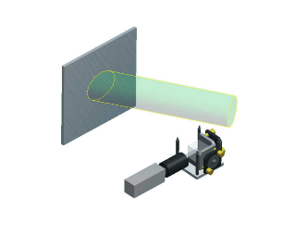
What are we measuring?
For an out of plane system
  Optical differential pattern requires
  further numerical differentiation
  to yield strain
An In plane sensitive only system
  Requires only optical differentiation to yield strain
  δL/L=ε useful for why things break
Hybrid out of plane/in plane systems require understanding of the loading and surface shape
In plane
y
x
z
Out of plane
delaminations adhesion, integrity

Slide 5
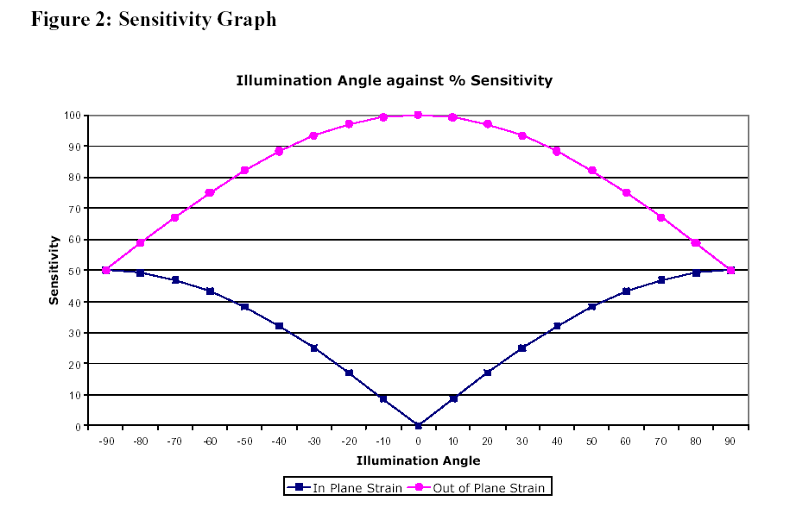
Sensitivity analysis of instrument

Slide 6
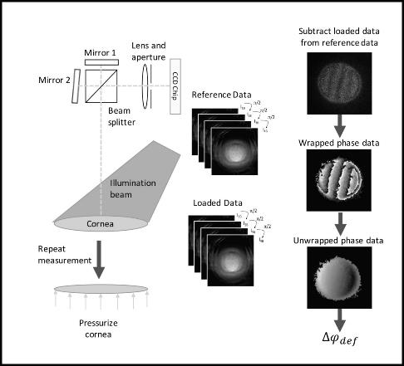
Shearing Interferometry
Different Sensitivities
Lateral (horizontal)
Lateral (Vertical)
object
Radial
Notes:
In order to get quantitative data phase stepping must be used, this involves capturing 3 or more images in each object state so the unknowns in the phase change equations can be determined allowing a specific phase change to be calculated for each pixel in an image, this results in a wrapped data map with fringes going from white to grey to black (from 0-2 PI). This data map must then be unwrapped to give the absolute phase change as in the wrapped data there are jumps from black to white due to phase jumps that occur between 0 and 2 PI. The continuous unwrapped phase data map gives the absolute phase change due to deformation which relates to displacement or rate of displacement dependent upon the optical set-up used.
Many different sensitivities are possible by changing the way the image is transformed and interfered with itself. Its possible to do lateral, radial, rotational and reverse shear. Radial has been used previously on the cornea as it is sensitive to the ‘bulging’ of the cornea, lateral has also been used as it is sensitive to either horizontal or vertical strain and out-of-plane (change in steepness of the cornea).

Slide 7
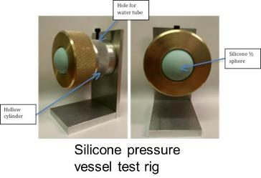
Lateral shearing interferometry (LSI) to give strain images
Rubber sample with superficial diagonal cut

Slide 8
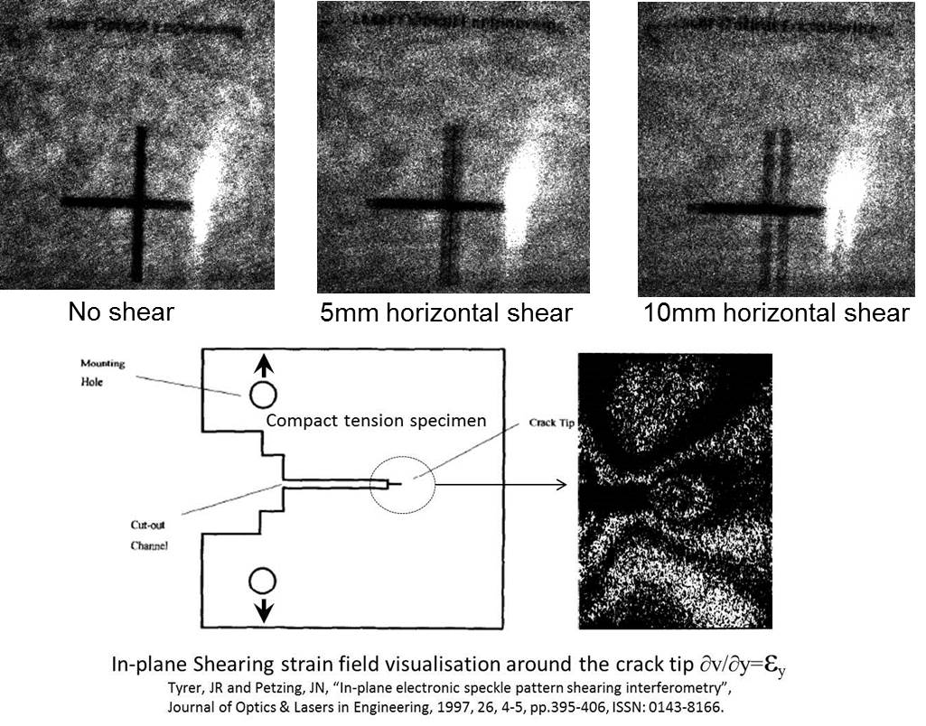
What is lateral shearing interferometry

Slide 9
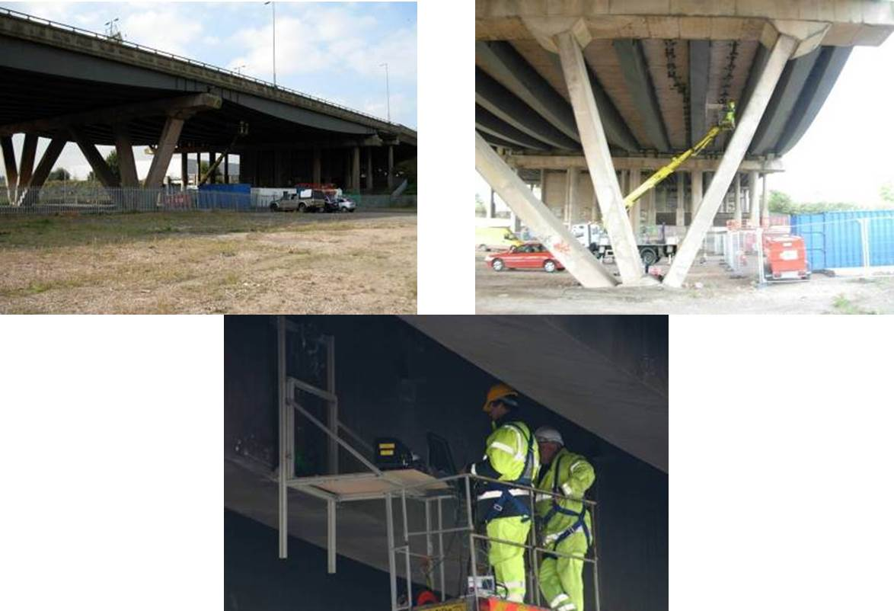
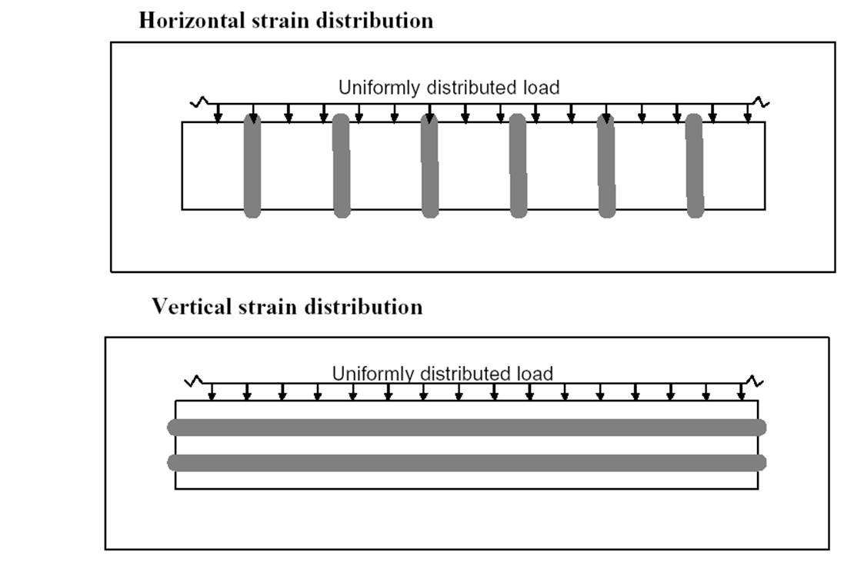
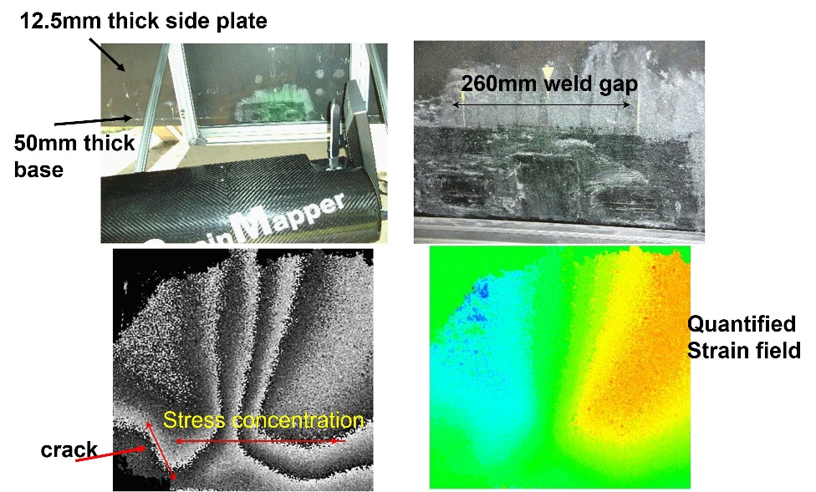
Big structures, Motorway Bridges
Shear of 3mm for the test
  104 με in the out-of-plane direction
  251 με in the in-plane direction
Strain value measured were in line with strain gauge results (at those points of gauging!!!)

Slide 10

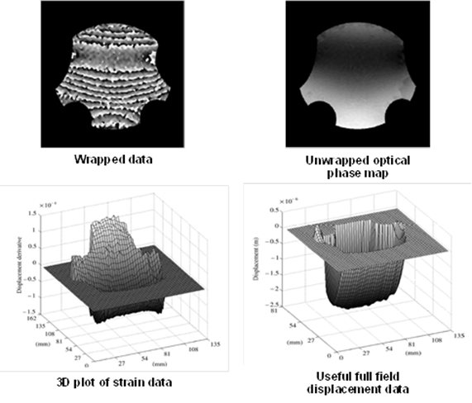
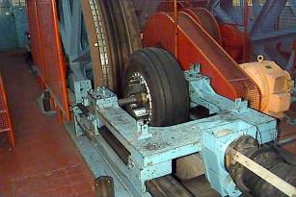
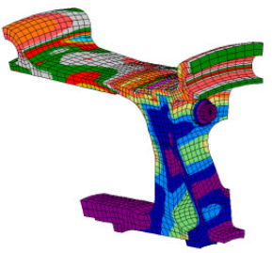
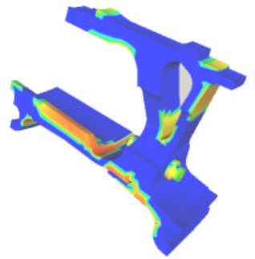
3D real structures NDT and Life prediction
Reversed Finite element solution
Fatigue life prediction

Slide 11
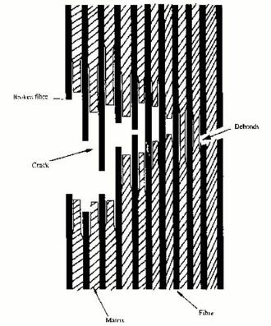
FAILURE MECHANISMS IN COMPOSITE
MATERIALS
Failure mechanisms in composites. These include:
  intralaminar matrix cracking, plastic flow,
  delamination fibre-matrix debonding, fibre pull-out, and fibre fracture.
Fracture depends upon a large number of parameters.
Fracture involves both macroscopic & microscopic failure mechanisms.
Key for energy dissipation in composite materials.
Here damage may involve failure of the fibre-matrix bond, fibre fracture, and plastic deformation, and failure of the matrix.

Slide 12
Defect types
Manufacturing defects
Delamination
resin-rich areas either within an individual ply or at a ply interface
distorted fibres such as ply waviness;
Under cured/over cured parts
Porosity and Voids
broken fibres;
inclusions such as dust or pre-preg backing paper.
In service defects
Defects occurs due to:-
Impact
Moisture/temperature degradation
Heat/fire damage
Fatigue
Fibre breakage
Fibre/matrix tensile strength is a structural requirement hence need for checking
Fibre/matrix interface is important for shear strength of structure

Slide 13
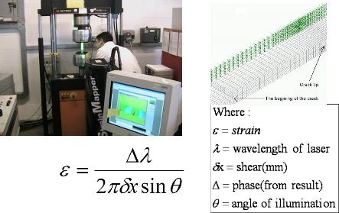
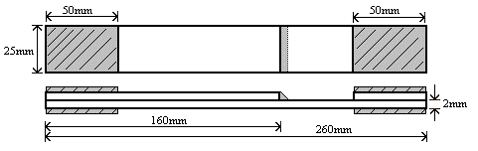
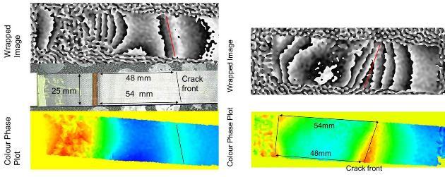
Bonded composite strap specimen geometry
adhesive
strap
lap

Slide 14




Variable Amplitude Loading (4-8kN at 5Hz, with 1-10 every 20 cycles)
Radiographs and interferograms of unidirectional CFRP secondary bonded with unsupported adhesive specimen, loaded with variable amplitude fatigue spectrum after (I) 40,000 loading cycles and (J) 45,000 loading cycles.
Fatigue crack growth graphs for uni-directional, secondary bonded specimens subjected to constant amplitude and variable amplitude spectra.
I
J
K
direction of crack propagation
L
crack tip
Damage zone has been “consumed”
damage zone
position of crack tip before ‘jump’
undamaged material
crack tip
position of crack tip after ‘jump’

Slide 15
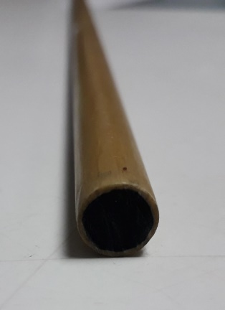
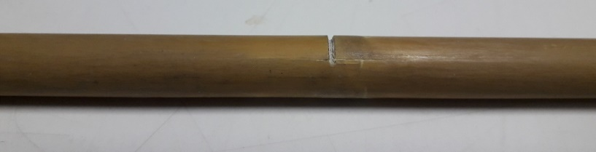
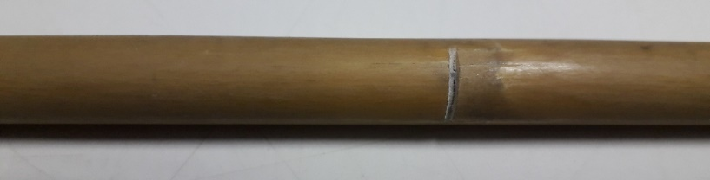
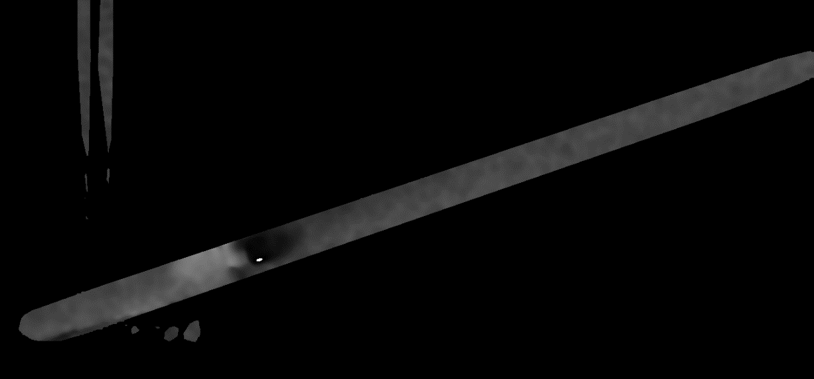

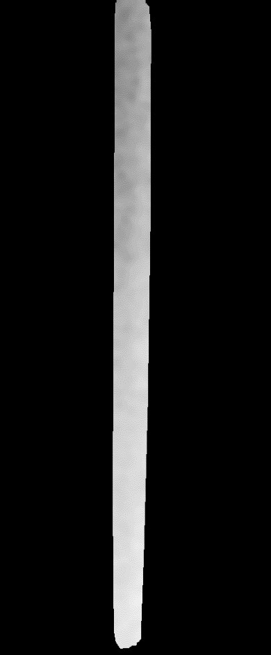
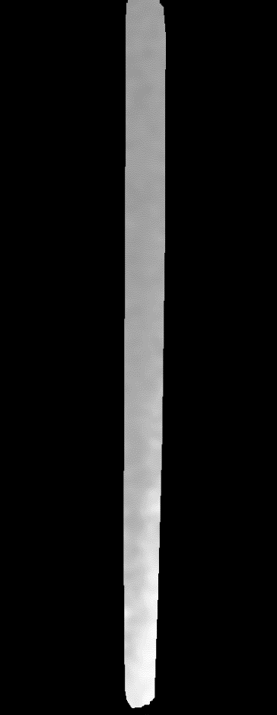
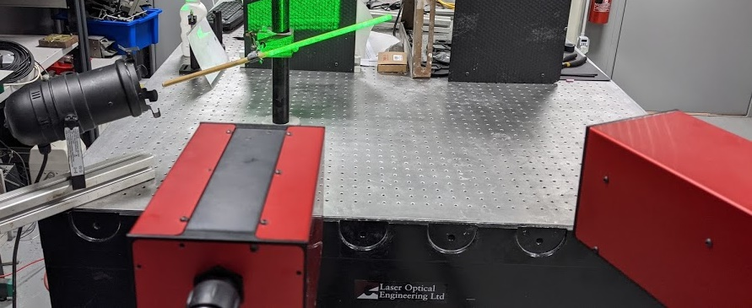
Carbon core rigging fibre cut/breakage
Carbon reinforced rod,
10 mm dia
Horizontal in-plane
Out-of-plane
NO RESULT!!!

Slide 16
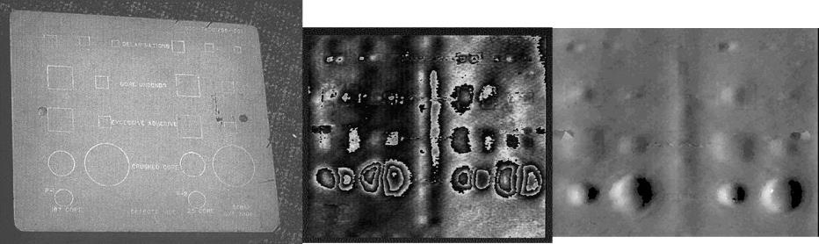
Creating NDT Standards – all Out of Plane!!!
ASTM E2581 – 14, Standard Practice for Shearography of Polymer Matrix Composites and Sandwich Core Materials in Aerospace Applications
BS EN 4179:2009; Aerospace series. Qualification and approval of personnel for non-destructive testing
NAS410 4th Edition, December 19, 2014; NAS CERTIFICATION & QUALIFICATION OF NONDESTRUCTIVE TEST PERSONNEL
SNT-TC-1A, 2011 Edition, and ASNT Standard Topical Outlines for Qualification of Nondestructive Testing Personnel (ANSI/ASNT CP-105-2011)
Disbonds, Crushed core, Excessive adhesive, Delaminations, Core unbonds all revealed in real time

Slide 17
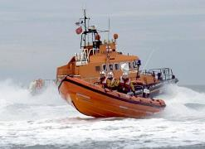
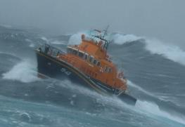
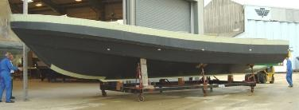
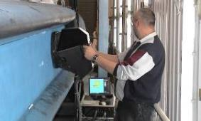
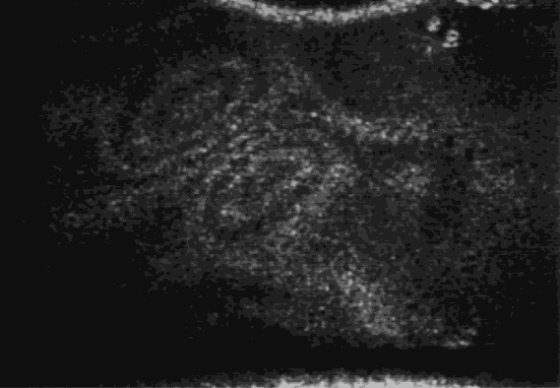
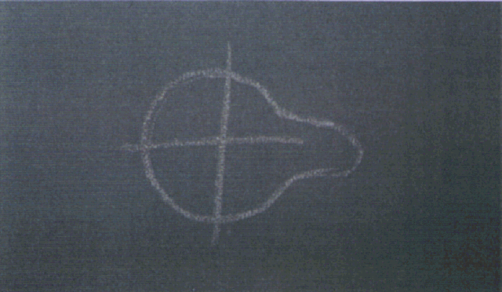
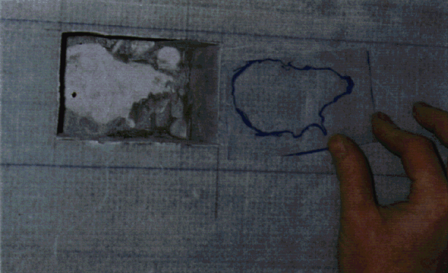

All carbon fibre composite new boat hulls, decks and superstructures are tested for RNLI
The hardware provides; High speed 1m² per min, reliable, repeatable and safety critical assessment, weighs 3.5kg
Ergonomic, capable of single person operation, fully complies with all safety and handling regulations. Information has to be presented in an unambiguous way and be suitably archived with all test parameters.
Laser Safety – Class 2, inherently safe in ALL conditions

Slide 18
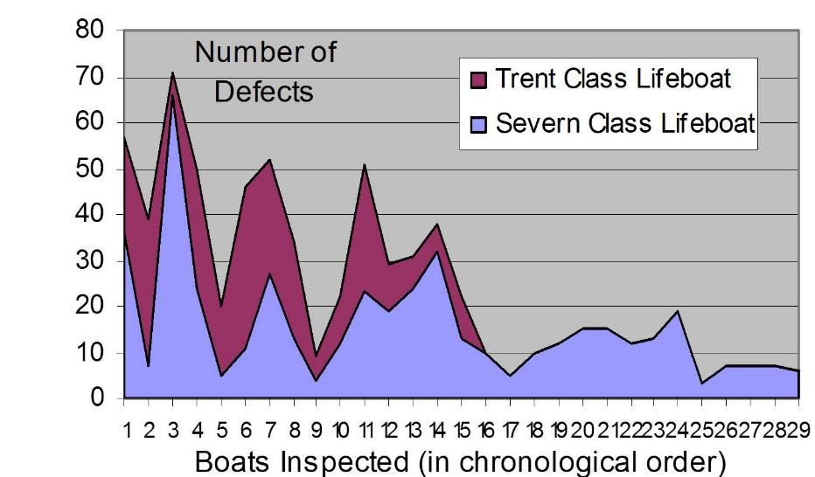
Improvements due to the introduction of shearography

Slide 19
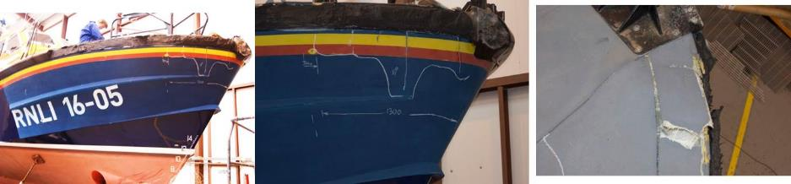
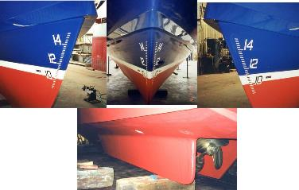
Defining the damage area
Tamar after frontal collision at speed with another vessel
Repair complete

Slide 20
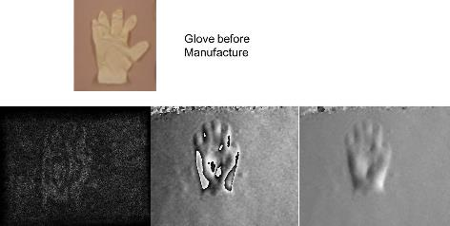
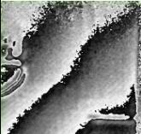
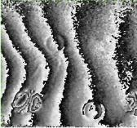
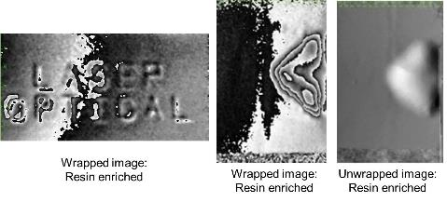
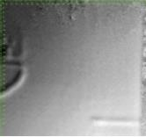
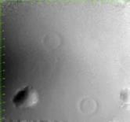
In-Service Defects; difference fringes, wrapped and unwrapped phase fringes
Side Hole defect
Crush Defects

Slide 21
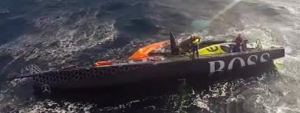
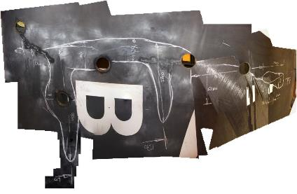
Submerged high speed impact damage
The underside of an high prestige ocean racing vessel that hit a submerged railway sleeper.
The longitudinals run either side of the letter ‘B’, on the left hand side you can just see the two little drill holes either side of the line showing wet and dry side.
The core samples had been taken prior to inspection, that’s when they realised they needed quantified inspection

Slide 22
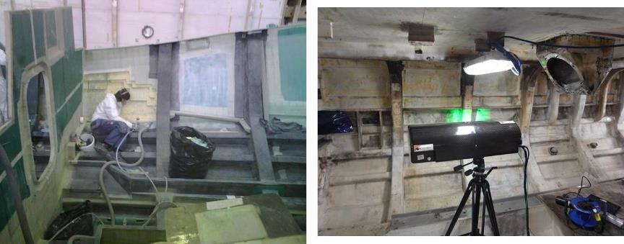
External audit leading to further investigatioon
Internals of a Tamar being removed after defect found from the outside, goes either side of the bulkhead
Internals of a pilot boat that had a fire in the engine room and the automatic fire prevention system didn’t kick in.

Slide 23


Carbon Core Rigging Inspection
The inspection device automatically detects damage to the carbon core rigging, this can be applied during:-
  Manufacture of the core
  Preparation of a joint, dead end or mid-span splice
  Checking rigging prior to despatch
  Checking rigging prior to installation
  Checking rigging after installation
  Forensic testing of rigging as part of an accident investigation

Slide 24





Automatic carbon rigging inspection
Tested 8m lengths in bespoke test frame

Slide 25

Inter-comparison of fatigue specimens – important for composite structure life extensions
undamaged
30g
45g

Slide 26
Concluding statements
Given an analysis of the types of failures experienced in fibre composite materials
Shown the difference in instrument configurations;
  in-plane and out-of-plane
Shown the influence of the defects and this goes beyond their outline perimeter – also how this influences residual life and repair strategies
Shown how an ‘active’ detection strategy offers benefits over conventional ‘passive’ techniques
We are now able to predict residual life in conventional ductile and FRP composite structures
We can satisfy the requirements of the MAIB

Slide 27
Thankyou for listening
Questions?
John Tyrer
Laser Optical Enginering Ltd
Building 72
Argosy Road
East Midlands Airport
Derbyshire
DE74 2SA
Tel; 01332 814612
Email; johntyrer@laseroptical.co.uk

